Slide 1
Label Informed Attributed Network Embedding
Xiao Huang et al.

Slide 2
Key points
Define the problem of label informed attributed network embedding
Providing a framework LANE, which can affiliate labels with the attributed network and smoothly embed them into a low-dimensional representation by modeling their structural proximities

Slide 3

Key points
Given an attributed network G associated with label information Y , we aim at representing each node i as a continuous low-dimensional vector representation:
Learning a mapping

Slide 4
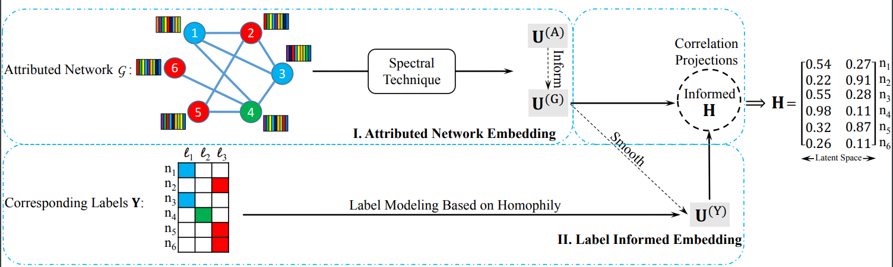
Label Informed Embedding Module
Mapping the node proximities in attributed network into U(G) and label proximity into U(Y ),
Incorporates them into a joint embedding representation H via correlation projections.

Slide 5



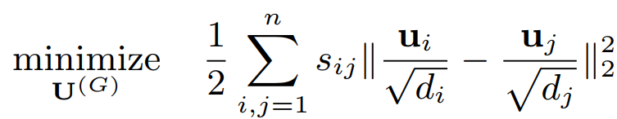
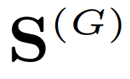
3.1. Attributed Network Embedding Module:
Modelling the geometrical proximity via the objective function:
rows of network latent representation
Degree of disagreement: between
s(.) is the cosin measure.
The total degree of disagreement by summing up the product of pairwise similarity:
the pairwise similarities as a graph affinity matrix

Slide 6
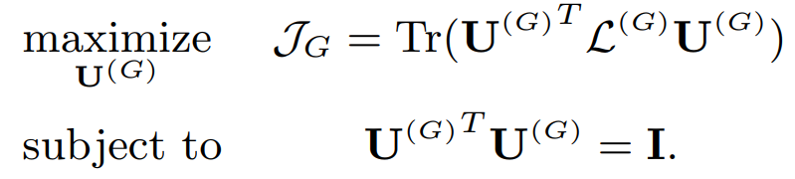
3.1 Attributed Network Embedding Module:
Based on the definition of normalized graph Laplacian[8]:
affinity matrix

Slide 7
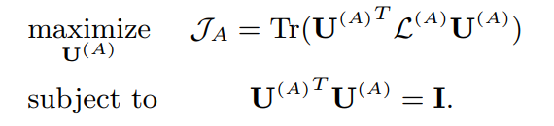



3.1 Attributed Network Embedding Module:
Objective function of node attributes embedding
Laplacian
attribute affinity matrix
To incorporate
Employ variance of the projected matrix as a measurement of the correlations[15]:
[15] I. Joliffe. Principal component analysis. Springer Verlag, 1986

Slide 8



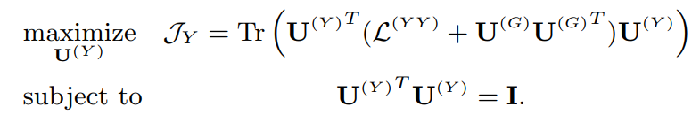
3.2 Label Informed Embedding Module
3.2.1 Label Information Modeling Consider nodes with the same label as a clique, and employ the learned network proximity to smooth the label information
Similar to :
Use proximity to smooth the modeling

Slide 9

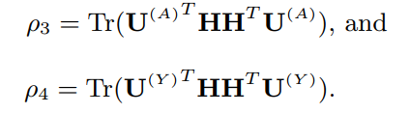

3.2 Label Informed Embedding Module
3.2.2 Correlation Projections
Specifically, since all of the latent representations are constrained by corresponding Laplacian, we project all of them into a new space H
The loss function for entire three projections is:

Slide 10
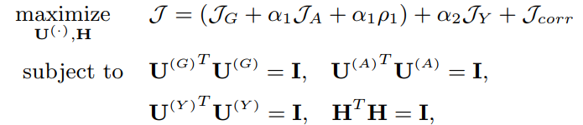
3.3 Joint Representation Learning via LANE

Slide 11
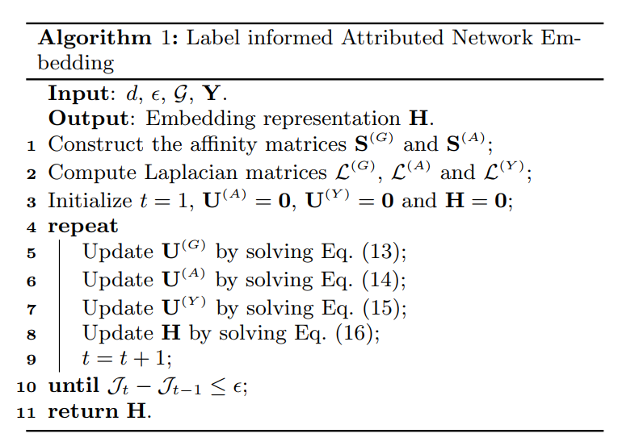
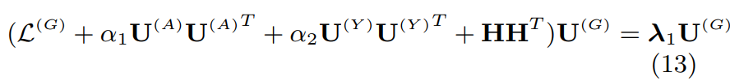
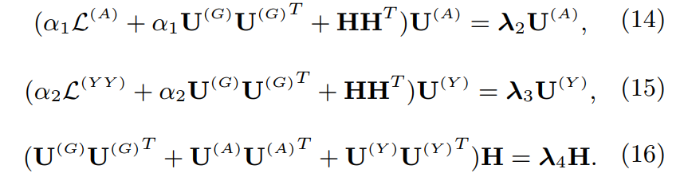
Label informed Attributed Network Embedding

Slide 12
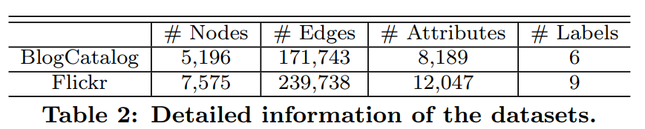
4. EXPERIMENTS
Datasets:

Slide 13
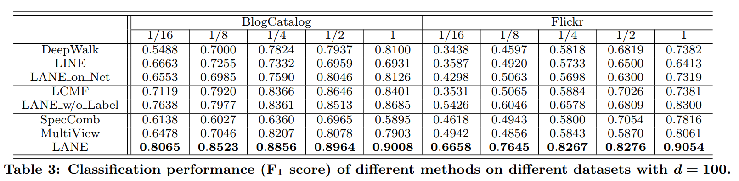
Performance Evaluation

